Slide 1
Cloud Club ☁️
CI/CD

Slide 2
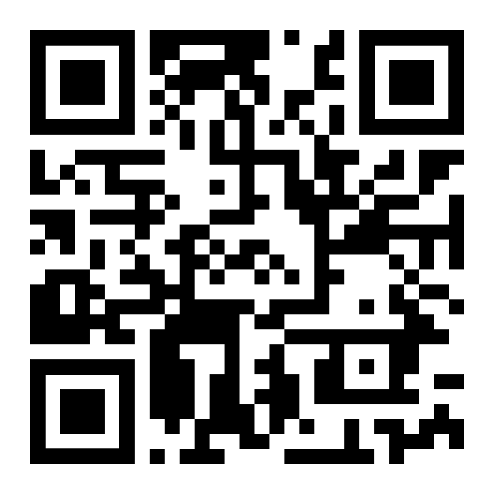
Cloud Club ☁️
Discord
https://discord.gg/V5H5Ex5Y7Y

Slide 3
Please join the student organization
Link can be found in discord

Slide 4
Schedule

Slide 5
Spring 2023 Schedule (tentative)
March 6, 2023
Continuous Integration & Continuous Deployment (CI/CD)
Hands-on-experience (GitHub Actions)
March 20, 2023
Discuss Docker
Hands-on-experience (Docker)
April 3, 2023
Recap on everything discussed
Project presentations
Notes:
⭐️IAC day is super awesome. Encourage everyone to attend this meeting.
Project Presentations is simply an opportunity for members to showcase any cloud-based projects they have built.

Slide 6
Continuous Integration &
Continuous Deployment (CI/CD)

Slide 7
Why use CI/CD?
Remove manual deployments
Ability to quickly deploy changes whenever needed
A better question is why wouldn’t you use CI/CD?

Slide 8

CI/CD with GitHub
GitHub Actions
Notes:
Visit Amazon S3

Slide 9
GitHub Actions
Built into GitHub
Simple to use
Easy to access - within GitHub repository
Allows for extremely advanced configurations
Notes:
Visit Amazon S3

Slide 10
Hands-on experience

Slide 11

Hands-on Experience
AWS Cloudformation + GitHub actions

Slide 12
Hands-on Experience
AWS Cloudformation
Within a GitHub repository, create a basic cloudformation template
Give the GitHub repository permission to deploy cloudformation to your AWS account
Create a github actions workflow file
Add a sam deploy step to your workflow file
Verify that your GitHub actions is successfully deploying your cloudformation stack

Slide 13
“Homework” for the next meeting
Join the Discord
Officially join the student organization
URL in #annoncements channel on Discord

